Slide 1

A MAJOR PROJECT PRESENTATION ON IDENTIFICATION OF BEST AGRICULTURAL PRACTICES
contributed by
Suraj Kumar
Bishnupada Karan
Chandan Kr. Satapathy
Vikas Kr. Singh
Department of Electronics and Telecommunication Engineering
C. V. Raman Global University
Bhubaneshwar, Odisha

Slide 2
Contents
Introduction
Motivation
Problem Statement
Literature Review
Proposed Methodology
Prototype
References

Slide 3
Introduction
Due to the increase in population there is a huge demand to maximize yeid in Agriculture *
Agriculture losses are mainly due to wrong agricultural practices **
High dependancy on harmful chemicals can be avoided by growing transgenic crops #
This project aims to reduce the loss and identify the best possible patterns in agriculture in Jharkhand State
Several factors such as soil types, weather, pesticides, insectisides are considered for this purpose
* Global agriculture towards 2050 - http://www.fao.org
** Problems in Agriculture: Loss of Land and Decreased Varieties - http://www.study.com
# Tabashnik et al., "Surge in insect resistance to transgenic crops and prospects for sustainability." Nature Biotechnology 35.10 (2017): 926.

Slide 4

Problem Statement
To provide the best agriculture practices in Jharkhand state
by identifying the appropriate parameters which can influence the productivity
by elemenating the loss due to orthodox/traditional methods of farming
by analyzing the previous years data and predict best combination between crops, pesticide, soiltypes, weather, etc with the help of Artificial Neural Network and various machine learning algorithms

Slide 5

Motivation
Annual crop losses due to plant diseases are estimated worldwide to be 35% *[1, 2]
High dependency on pesticides and other harmful chemicals leads to decay in soil fertility **
Improper information about crop and corresponding pesticides causes loss in large scale #
Environment is highly affected due to wrong agliculture techniques
* [1] https://www.thehindu.com/news/national/pests-eat-away-35-of-total-crop-yield-says-icar-scientist/article17368426.ece
* [2] https://www.cropscience.bayer.com/people-planet/climate-change/a/stopping-crop-losses
** Problems in Agriculture: Loss of Land and Decreased Varieties - http://www.study.com
# Dhaliwal, G. S., Vikas Jindal, and Bharathi Mohindru. "Crop losses due to insect pests: global and Indian scenario." Indian Journal of entomology 77.2 (2015): 165-168.

Slide 6
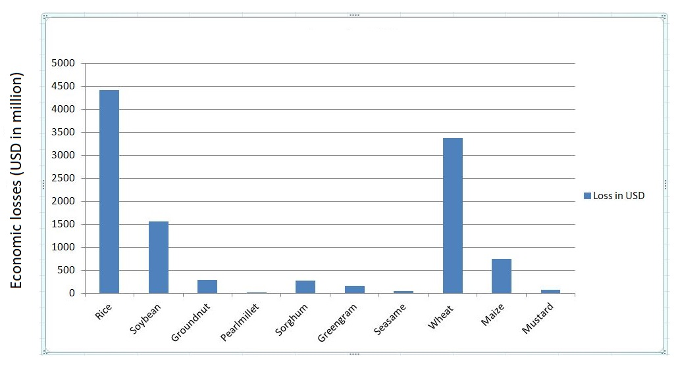
Motivation
Fig: Economic losses (USD in million) due to weeds in 10 major field crops of India in year 2004-13 *
*Gharde, Yogita, et al. "Assessment of yield and economic losses in agriculture due to weeds in India." Crop Protection 107 (2018): 12-18

Slide 7
Literature Review
S.No. | Authors/Publisher/Journal/ Year | Name | Method | Pros and Cons
1. | Yogita Gharde et al.,/Elsevier/2018 | Assessment of yield and economic losses in agriculture due to weeds in India | Analyzing agricultural losses due to weeds in India | Economical impacts due to losses in different parts of the country
2. | Bruce E Tabashnik et al.,/Springer Nature/2017 | Surge in insect resistance to transgenic crops and prospects for sustainability | Genetically Engineered Crops | Benifits of DNA encoding in plants, Lack of cost estimation
3. | Philip J. Dale et al.,/Nature/2002 | Potential for the environmental impact of transgenic crops | Transgenic crops | Effect of transgenic crops on environment, Fate of free DNA in environment
4. | Muhammad et al.,/Springer/Journal of Pest Science/2020 | Fluctuating temperatures infuence the susceptibility of pest insects to biological control agents | Effect of fluctuating temperature on the susceptibility of pest insects to agricultural management. | Infuence of temperature on larval performance

Slide 8
Literature Review*
S.No. | Authors/Publisher/Journal/ Year | Name | Method | Pros and Cons
5. | Ch. Srinivasa Rao et al.,/Elsevier/2018 | Agro-ecosystem based sustainability indicators for climate resilient agriculture in India: A conceptual framework | Identifying indicators for measuring climate resilient agriculture | Increasing adaptive capacity & building resilience.
6. | Thomas L. Saaty/International Journal of Services Sciences/2008 | Decision making with the analytic hierarchy process | Multi-criteria Decision Making using Analytic hierarchy process | Robust & simple MCDM
*Updated Literature review

Slide 9
Proposed Methodology
Database collection of Jharkhand *[1,2]
Identifying the inputs features - Crop type, Pesticide type, Soil type, climate
Identification of ideal combination using WSM & AHP #
Finding the outputs - Yield %, Loss%
Design of ANN(Artificial Neural Network) model
Training of model using various algorithm - Backpropagation, SVM(Support Vector Machines), Logistic regression, etc.
*[1]Jharkhand State agriculture dvelopment plan - http://rkvy.nic.in/static/SAP/JH.pdf
*[2]Season-wise crop report - http://desjharkhand.nic.in/agriculturestatistic.html
#Updated point post pre-evaluation

Slide 10
Methods:
Robust & simple multi-criteria decision analysis(MCDA) for evaluating no. of alternatives & relative weights of decision criteria.
WSM(Weighted sum Model):
AHP(Analytic Hierarchy Process):*[6]
A robust MCDA technique
AHP tree built by hierarchy of “decision criteria”.
AHP alorithm determines the relative ranking of alternatives.
where, w_{j}= relative weight of importance of the criterion
a _{ij} = performance value of alternative A_{i} when it is evaluated in terms of criterion
A ^{Wsm-score} = total importance of alternative A _{i}

Slide 11
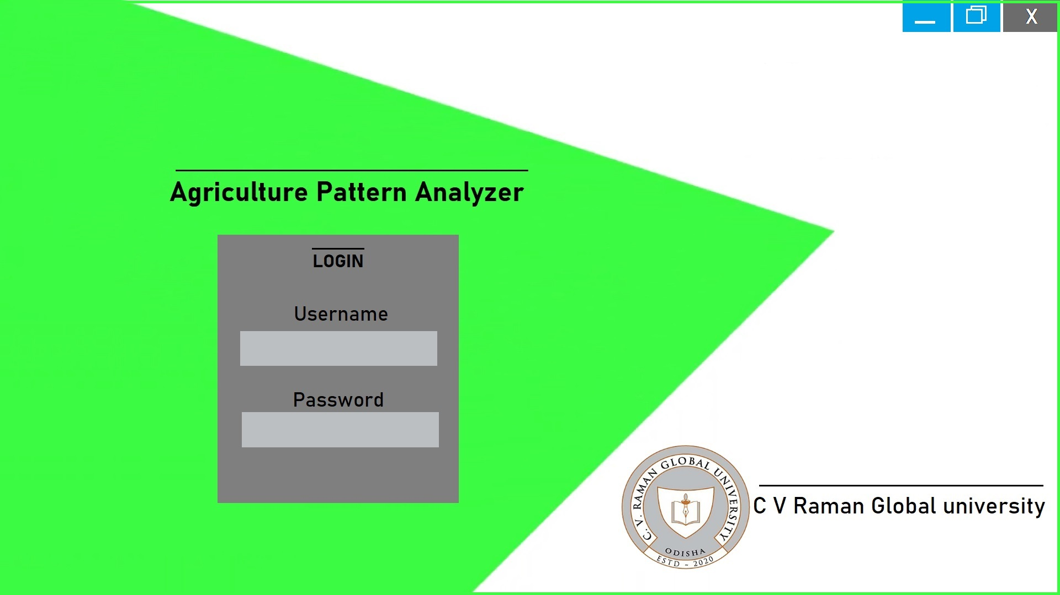
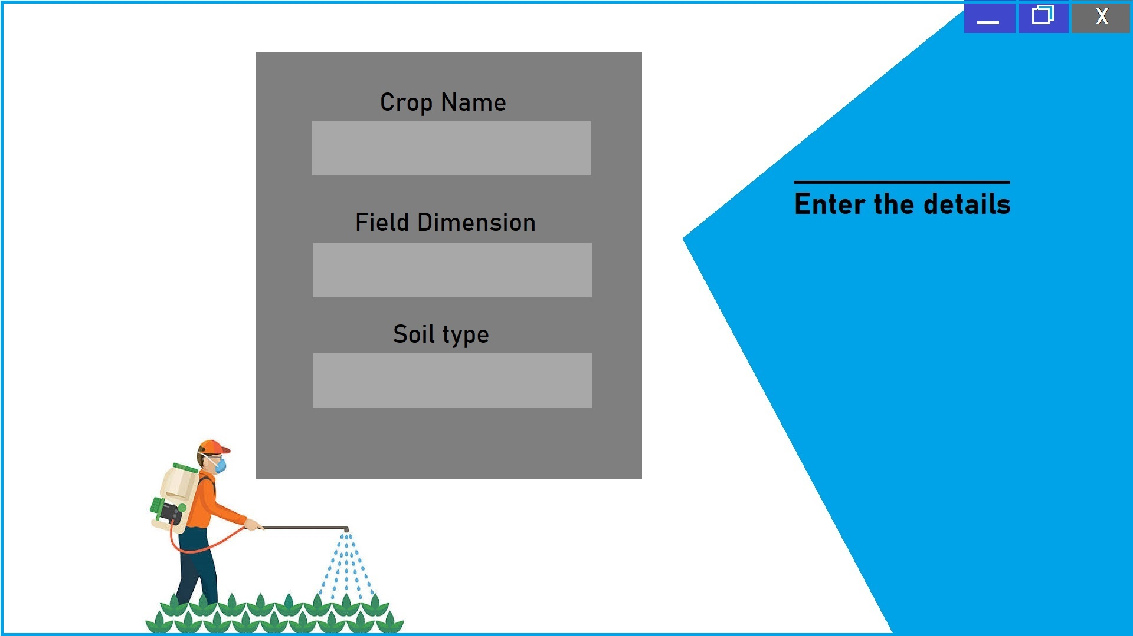
Prototype/Front-end of the System to be implemented in Django-Python

Slide 12
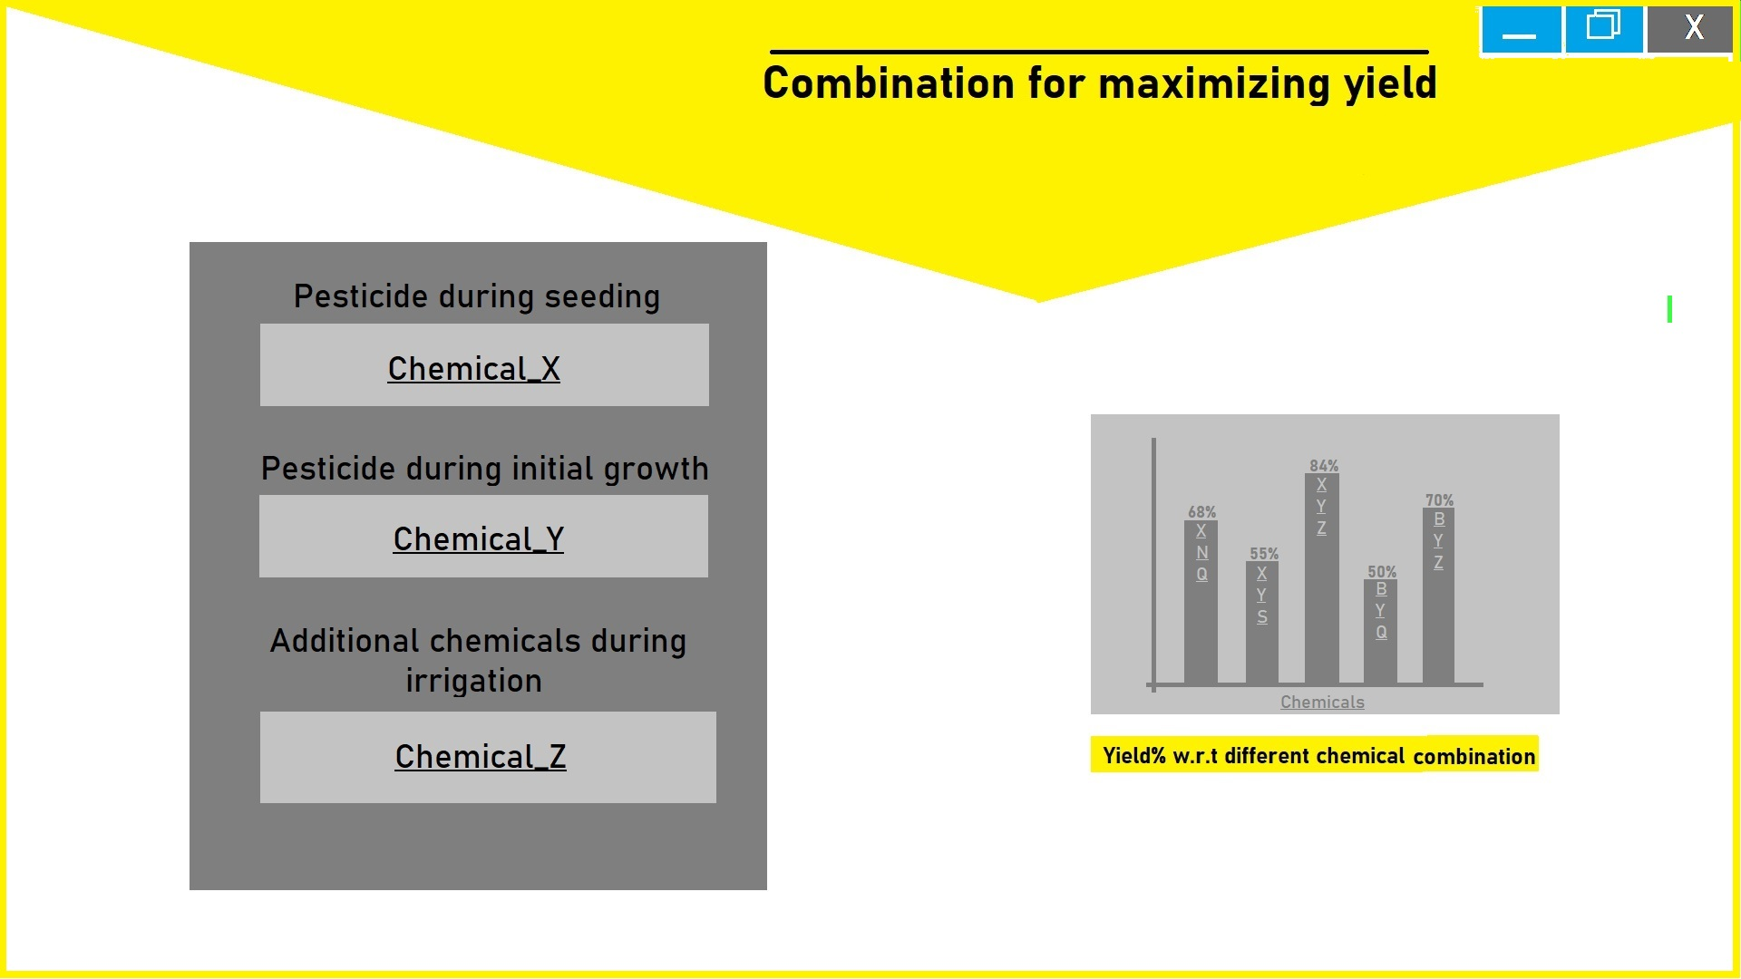
Prototype/Front-end of the System to be implemented in Django-Python
* Tools used: MS Paint (further to be implemented using Django-python

Slide 13
References
1. Gharde, Yogita, et al. "Assessment of yield and economic losses in agriculture due to weeds in India." Crop Protection 107 (2018): 12-18.
2. Tabashnik, Bruce E., and Yves Carrière. "Surge in insect resistance to transgenic crops and prospects for sustainability." Nature Biotechnology 35.10 (2017): 926.
3. Dale, Philip J., Belinda Clarke, and Eliana MG Fontes. "Potential for the environmental impact of transgenic crops." Nature biotechnology 20.6 (2002): 567-574.
4. Ghazanfar, Muhammad Usman, et al. "Fluctuating temperatures influence the susceptibility of pest insects to biological control agents." Journal of Pest Science (2020): 1-12.
5. Rao, Ch Srinivasa, et al. "Agro-ecosystem based sustainability indicators for climate resilient agriculture in India: A conceptual framework." Ecological Indicators 105 (2019): 621-633.
6. Saaty, Thomas L. "Decision making with the analytic hierarchy process." International journal of services sciences 1.1 (2008): 83-98.

